Slide 1
RATINGS PREDICTION PROJECT
SUBMITTED BY-
TRIBENI SUBUDHI

Slide 2
INTRODUCTION
This is a Machine Learning Project performed on customer reviews. Reviews are processed using common NLP techniques.
Millions of people use Amazon and Flipkart to buy products. For every product, people can rate and write a review. If a product is good, it gets a positive review and gets a higher star rating, similarly, if a product is bad, it gets a negative review and lower star rating. My aim in this project is to predict star rating automatically based on the product review.
The range of star rating is 1 to 5. That means if the product review is negative, then it will get low star rating (possibly 1 or 2), if the product is average then it will get medium star rating (possibly 3), and if the product is good, then it will get higher star rating (possibly 4 or 5).
This task is similar to Sentiment Analysis, but instead of predicting the positive and negative sentiment (sometimes neutral also), here we need to predict the rating.

Slide 3
MATHEMATICAL/ANALYTICAL MODELLING OF THE PROBLEM
This project is done in two parts:
Data collection phase
Model Building phase

Slide 4
In Data collection phase, we will scrape nearly 38438 of reviews data from e-commerce websites like Amazon and it is collected by using Webscraping and Selenium.
Fetch an equal number of reviews for each rating, for example if you are fetching 10000 reviews then all ratings 1,2,3,4,5 should be 2000. It will balance our data set.
Convert all the ratings to their round number, as there are only 5 options for rating i.e., 1,2,3,4,5. If a rating is 4.5 convert it 5.
After collecting the data, you need to build a machine learning model. Before model building do all data pre-processing steps involving NLP. Try different models with different hyper parameters and select the best model. Follow the complete life cycle of data science. Include all the steps like-
1. Data Cleaning
2. Exploratory Data Analysis
3. Data Pre-processing
4. Model Building
5. Model Evaluation
6. Selecting the best model

Slide 5
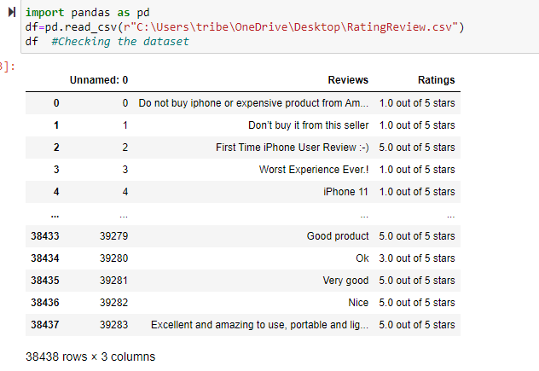
DATA SOURCES AND THEIR FORMATS

Slide 6
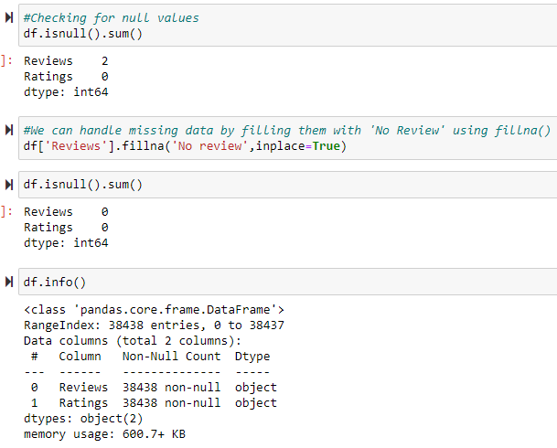
DATA PRE-PROCESSING
Handling missing data using fillna and checking the datatypes

Slide 7
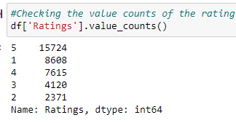
Checking average rating and value counts of each rating present

Slide 8
Pre-processing using Natural Language Processing (NLP):
We cleaned the data using regex, matching patterns in the comments and replacing them with more organized counterparts. Cleaner data leads to a more efficient model and higher accuracy. Following steps are involved:
1. Removing Punctuations and other special characters
2. Splitting the comments into individual words
3. Removing Stop Words
There is a corpus of stop-words, that are high-frequency words such as "the", "to" and "also", and that we sometimes want to litter out of a document before further processing. Stop-words usually have little lexical content, don’t alter the general meaning of a sentence and their presence in a text fails to distinguish it from other texts. We used the one from Natural Language Toolkit a leading platform for building Python programs to work with human language.

Slide 9
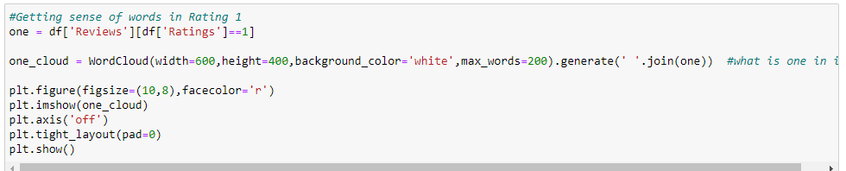
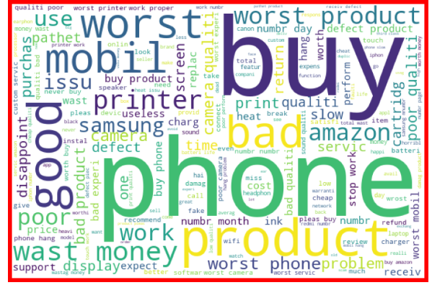
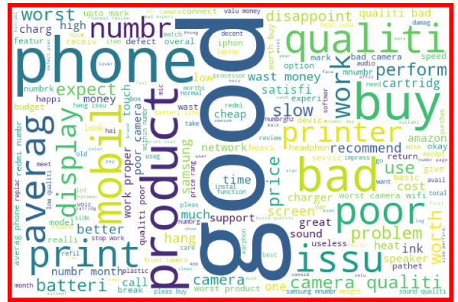

Slide 10
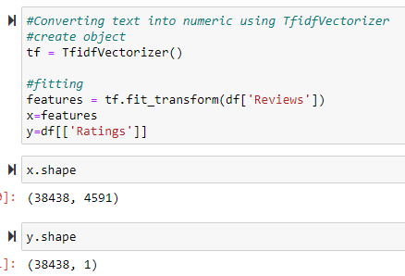
This is very common algorithm to transform text into a meaningful representation of numbers which is used to fit machine algorithm for prediction.

Slide 11
HARDWARE AND SOFTWARE REQUIREMENTS AND TOOLS USED
For doing this project, the hardware used is a laptop with high end specification and a stable internet connection. While coming to software part, I had used anaconda navigator and in that I have used Jupyter notebook to do my python programming and analysis.
For using an CSV file, Microsoft excel is needed. In Jupyter notebook, I had used lots of python libraries to carry out this project and I have mentioned below with proper justification:

Slide 13
MODEL/S DEVELOPMENT AND EVALUATION
Running and evaluating the models

Slide 14
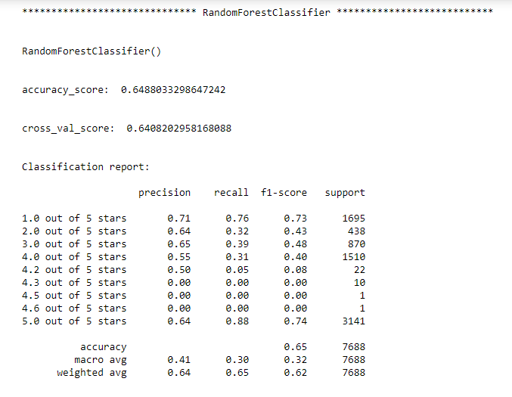
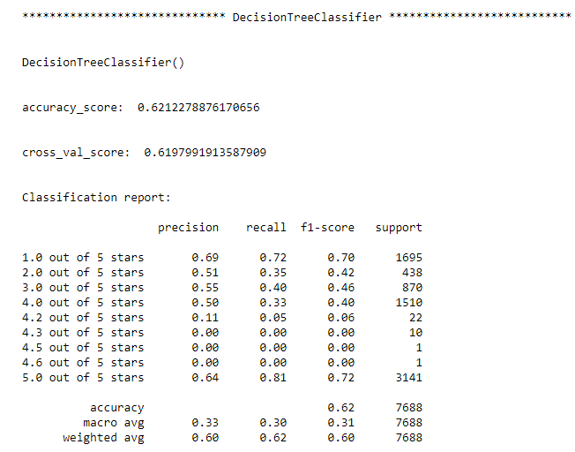
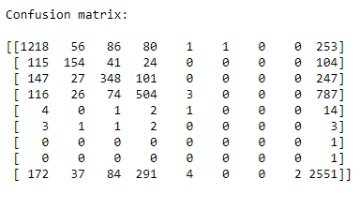
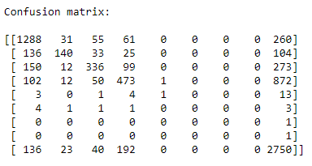
These were the best 2 models obtained among all other algorithms and we will perform hyperparameter Tuning to find out the best parameters and increase our scores

Slide 15

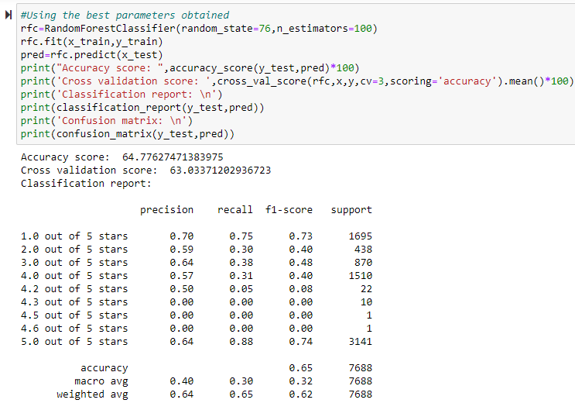
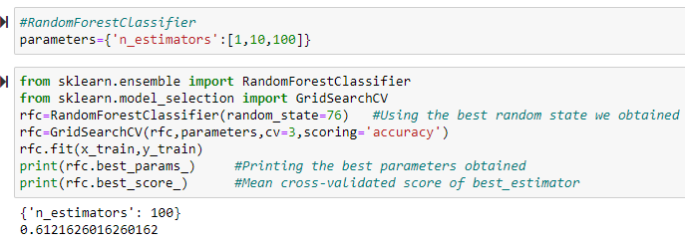
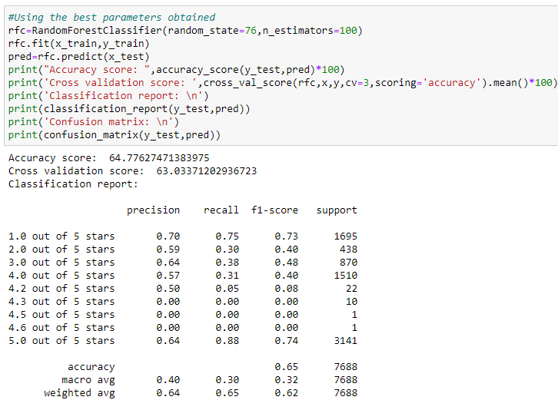
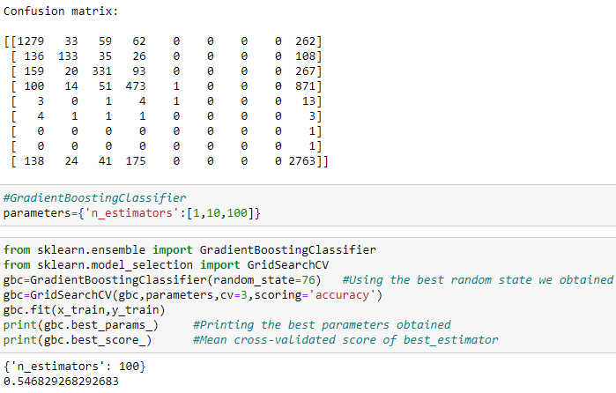
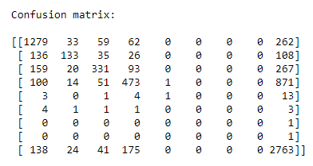
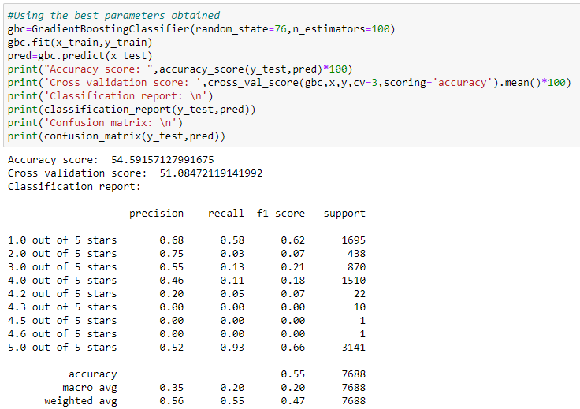

Slide 16
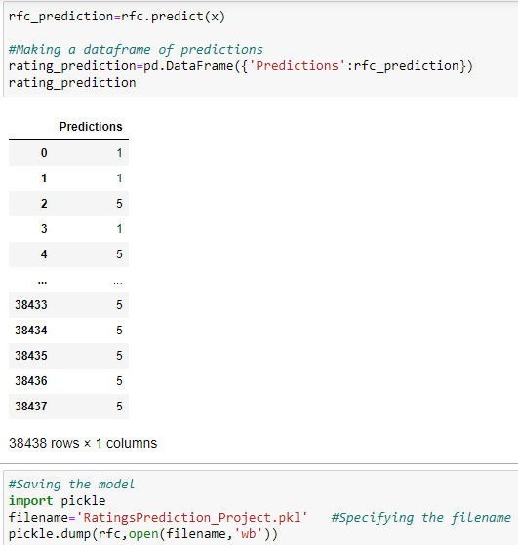
FINAL THE MODEL

Slide 17
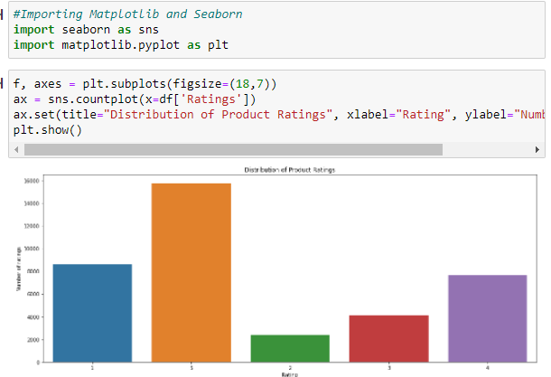
DATA VISUALIZATION

Slide 18
CONCLUSION
After the completion of this project, we got an insight of how to collect data, pre-processing the data, analysing the data and building a model.
First, we collected the reviews and ratings data from different e-commerce websites like Amazon and Flipkart and it was done by using Webscraping. The framework used for webscraping was Selenium, which has an advantage of automating our process of collecting data.
We collected almost 38438 of data which contained the ratings from 1.0 to 5.0 and their reviews.
Then, the scrapped data was combined in a single dataframe and saved in a csv file so that we can open it and analyze the data.

Slide 19
The problems we faced during this project were:
More time consumption during hyperparameter tuning for both models, as the data was large.
Less number of parameters were used during tuning.
Scrapping of data from different websites were of different process and the length of data were differing in most cases.
Some of the reviews were bad and the text had more wrong information about the product.
WordCloud was not showing proper text which had more positive and negative weightage.
Areas of improvement:
Less time complexity
More computational power can be given
Less errors can be avoided.

Slide 20


